Slide 1
Conjunto de instrucciones
La arquitectura SPARC tiene cerca de 50 instrucciones enteras, unas pocas más que el anterior diseño RISC, pero menos de la mitad del número de instrucciones enteras del 6800 de Motorola.
Las instrucciones de SPARC se pueden clasificar en cinco categorías

Slide 2
LOAD y STORE (la única manera de acceder a la memoria). Estas instrucciones usan dos registros o un registro y una constante para calcular la dirección de memoria a direccionar. (PREFETCH)
Instrucciones Aritméticas/Lógicas/Shift. Ejecutan operaciones aritméticas, lógicas y de desplazamiento de bits. Estas instrucciones calculan el resultado si es una función de 2 operandos y guardan el resultado en un registro. (FMOV)
Operaciones del Coprocesador. La IU extrae las operaciones de coma flotante desde las instrucciones del bus de datos y los coloca en la cola para la FPU. La FPU ejecuta los cálculos de coma flotante con un número fijo en unidad aritmética de coma flotante (el número es dependiente de la aplicación). (TBR, WIM, PSR)
Instrucciones de Control de Transferencia. Estas incluyen jumps, calls, traps y branches. El control de transferencia es retardado usualmente hasta después de la ejecución de la próxima instrucción, así el pipeline no es vaciado porque ocurre un control de tiempo. De este modo, los compiladores pueden ser optimizados por ramas retardadas. (CALL)
Instrucciones de control de registros Read/Write. Estas instrucciones se incluyen para leer y grabar el contenido de varios registros de control. Generalmente la fuente o destino está implícito en la instrucción. (RDASR, WRASR)

Slide 3
FCMP, FCMPE: Floating-Point Compare: Can set any of the four floating-point condition codes
LDUW, LDUWA (same as “LD, LDA” in SPARC V8)
LDFSR, STFSR: Load/Store FSR: Only affect low-order 32 bits of FSR
RDASR/WRASR: Read/Write State Registers: Access additional registers
SAVE/RESTORE
SETHI
SRA, SRL, SLL: Shifts: Split into 32-bit and 64-bit versions
Tcc: (was Ticc): Operates with either the 32-bit integer condition codes (icc), or the 64-bit integer condition codes (xcc)
All other arithmetic operations now operate on 64-bit operands and produce 64- bit results. Application software written for SPARC V8 cannot detect that arithmetic operations are now 64 bits wide. This is due to retention of the 32-bit integer condition codes (icc), addition of 64-bit integer condition codes (xcc), and the carry-propagation rules of two’s-complement arithmetic. The following instructions have been added to provide support for 64-bit operations and/or addressing:
F[sdq]TOx: Convert floating point to 64-bit word
FxTO[sdq]: Convert 64-bit word to floating point
FMOV[dq]: Floating-point Move, double and quad
FNEG[dq]: Floating-point Negate, double and quad
FABS[dq]: Floating-point Absolute Value, double and quad
LDDFA, STDFA, LDFA, STFA: Alternate address space forms of LDDF, STDF, LDF, and STF
LDSW: Load a signed word
LDSWA: Load a signed word from an alternate space
LDX: Load an extended word
LDXA: Load an extended word from an alternate space
LDXFSR: Load all 64 bits of the FSR register
STXA: Store an extended word into an alternate space
STXFSR: Store all 64 bits of the FSR register

Slide 4
The following instructions have been added to support the new trap model:
DONE: Return from trap and skip instruction that trapped
RDPR and WRPR: Read and Write privileged registers
RESTORED: Adjust state of register windows after RESTORE
RETRY: Return from trap and reexecute instruction that trapped
RETURN: Return
SAVED: Adjust state of register windows after SAVE
SIR: Signal Monitor (generate software-initiated reset) The following instructions have been added to support implementation of higherperformance systems:
BPcc: Branch on integer condition code with prediction
BPr: Branch on integer register contents with prediction CASA, CASXA: Compare and Swap from an alternate space
FBPfcc: Branch on floating-point condition code with prediction
FLUSHW: Flush windows
FMOVcc: Move floating-point register if condition code is satisfied
FMOVr: Move floating-point register if integer register contents satisfy condition
LDQF(A), STQF(A): Load/Store Quad Floating-point (in an alternate space)
MOVcc: Move integer register if condition code is satisfied
MOVr: Move integer register if register contents satisfy condition
MULX: Generic 64-bit multiply
POPC: Population Count
PREFETCH, PREFETCHA: Prefetch Data
SDIVX, UDIVX: Signed and Unsigned 64-bit divide

Slide 5
The definitions of the following instructions have changed:
IMPDEPn: SPARC V8 CPop instructions have been replaced by VIS, IMPDEP2A, and IMPDEP2B instructions. The following instruction was added to support memory synchronization:
MEMBAR: Memory barrier The following instructions have been deleted:
Coprocessor loads and stores
RDTBR and WRTBR: TBR no longer exists. It has been replaced by TBA, which can be read/written with RDPR/WRPR instructions.
RDWIM and WRWIM: WIM no longer exists. WIM has been subsumed by several register-window state registers.
RDPSR and WRPSR: PSR no longer exists. It has been replaced by several separate registers which are read/written with other instructions.
RETT: Return from trap (replaced by DONE/RETRY).
STDFQ: Store Double from Floating-point Queue (replaced by the RDPR FQ instruction).

Slide 6
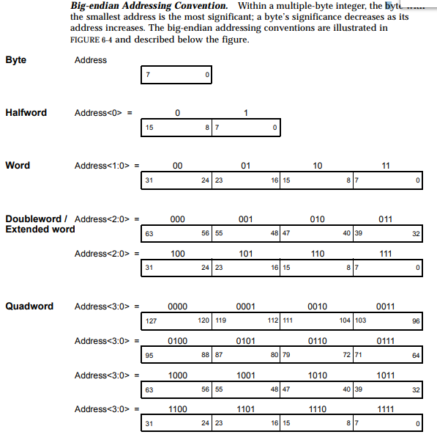
Tipos de datos

